Slide 1
Preventive Health Care Intelligent ecoSystem
Mindaugas Leonavičius I m.leonavicius@intellerts.com

Slide 2
Our mission is to create a digital health environment by employing great doctor knowledge, latest data technologies and advance wearables, to help our users/patients to prevent diseases and to keep health in great conditions.
We are introducing unique preventive health care solution - “dHealth”

Slide 3
Challenges

Slide 4
Switching the focus to prevention with strong primary care
According to OECD and World Health Organization, the prevention has been estimated to offer an enormous return on health expenditure, be it through better health outcomes, higher productivity, and employability, or saved treatment costs.
However, healthcare providers continue to devote only a small fraction of their attention and resources to preventive interventions, mainly because of lack of technological capabilities to provide preventive health services.
Prevention is better than cure

Slide 5
Impact of Chronic diseases
Between 70% and 80% of European healthcare costs are spent on chronic care, amounting to €700bn in the EU. Chronic diseases account for over 86% of deaths in the EU.
Despite the fact that prevention is the key to saving lives and saving money, only around 3% of health budgets are currently spent on prevention measures.
According to the World Health Organization, the health care systems focused on treatment rather than prevention will struggle to meet the challenges of tomorrow (Euro WHO 2017).
Strengthening primary care by moving care into the community and developing the role of providers outside the hospital is another important trend (Euro WHO 2017)
.

Slide 6
Costs of Noncommunicable diseases (NCD)
Increased wealth and longer lives mean that in most countries, non-communicable diseases are the biggest causes of death.
Despite extensive research, the search for definitive cures for cardiovascular diseases, cancer or diabetes remains a difficult one.
The World Economic Forum estimates that chronic disease will cost the global economy US$47 Trillion between 2010 and 2030.
According to World Health Organization over the past decade, cardiovascular diseases (CVD) has become the single largest cause of death worldwide, representing nearly 30% of all deaths and about 50% of noncommunicable diseases deaths.
According to the newest World Health Organization fact sheets, noncommunicable diseases kill 40 million people each year, equivalent to 70% of all deaths globally.
Cardiovascular diseases account for most noncommunicable diseases deaths or 17.7 million people annually.
Notes:
What exactly are NCDs? They are defined as diseases of long duration, generally slow progression, and they are the major cause of adult mortality and morbidity worldwide (WHO, 2005a). Four main diseases are considered to be dominant in NCD mortality and morbidity: cardiovascular diseases (including heart disease and stroke), diabetes, cancer and chronic respiratory diseases (including chronic obstructive pulmonary disease and asthma).

Slide 7
Costs of Cardiovascular Disease
According to World Health Organization in 2010, the global cost of CVD is estimated at US$ 863 billion (an average per capita cost of US$ 125), and it is estimated to rise to US$ 1,044 billion in 2030 – an increase of 22%.
Richer countries currently shoulder higher costs. Overall, the cost for CVD could be as high as US$ 20 trillion over the 20-year period (an average per capita cost of nearly US$ 3,000).
Currently, about US$ 474 billion (55%) is due to direct healthcare costs and the remaining 45% to productivity loss from disability or premature death, or time lost from work because of illness or the need to seek care.

Slide 8
SOLIUTION

Slide 9
What is dHealth
“dHealth” continuously monitors bio-signals of a human and by empowering artificial intelligence algorithms analyses health data and provides recommendations, combining prognostic insights and findings from medical professionals.

Slide 10
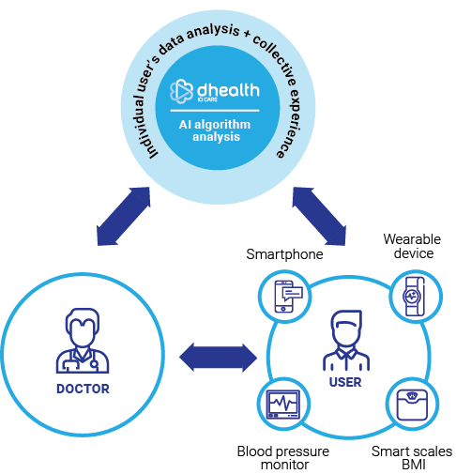
What it does
The dHealth solution:
provides environment and tools to collect vast personal data and to integrate those data into individualized predictive models.
creates precise risk profiles and prevention strategies using highly individualized data in the care of a specific patient.
acts as a doctor’s assistant (“Doctor of Me”) constantly monitoring the patient and estimating incoming health telemetry data as well as providing automatic preliminary guidance.
provides a platform from which doctors can deliver tailored interventions (feedback, alerts, recommendations) based on algorithms that continually optimize for personal information in real time.
It allows the patient and the doctor to make further decisions about the actions which must be taken to control the health risks.

Slide 11
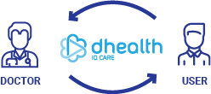
Value of dHealth system
The dHealth enables “P4” — predictive, personalised, preventive and participatory medicine.
Improve patients’ health literacy and the ability to understand health and medical information to make decisions to maintain or improve their health.
Data assessments and predictions helps to:
reduce the time needed to make an accurate diagnosis
improves patient outcomes
frees the time of the doctor
decreased cost of care.
The dHealth acts as personal health assistants by warning patients on future health risks and will guide patients to mitigate and prevent them.
The dHealth support health anytime, anywhere by allowing patient to have access to communication platform with doctors.

Slide 12
How it works
dHealth solution delivers preventive and near real-time health analytics using sensor and traditional health data in close combination.
dHealth solution is extracting the meaning from bio-signal changes (health deltas) and providing daily monitoring of health status.
The dHealth solution implements machine learning for health risk evaluation to prevent diseases.
In case of any unexpected events, the system will early warn the patient and starts required real-time intervention and prevention.
dHealth solution automatically adopts personal recommendations according to patient daily status and health score forecast.
The future of medicine belongs to continuous medicine

Slide 13
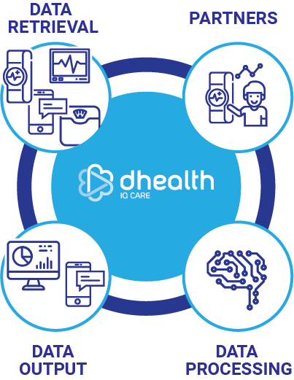
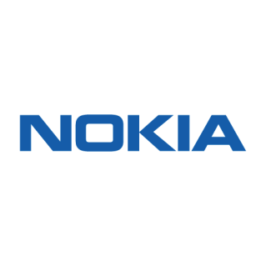
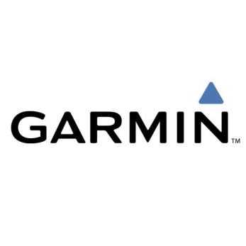
How it works
The dHealth soliution uses wearable devices offered by carefully selected manufacturers, and provides a detailed analysis of the health status using the data received from the devices.

Slide 14
“Doctor of Me”
The dHealth solution complements traditional doctors with the power of deep and preventive analytics. “Dr. of Me” available everywhere and when I need it. Health assistant is watching over us in real time.
Traditional doctors
AI and ML - Deep and
preventive analytics
“Dr. of Me”

Slide 15
Why dHealth is better than traditional health providers?
Preventive
Diagnostics
Treatment
Rehabilitation
Disease Management
promoting healthy lifestyle
early detection
preventive measures
symptom detection & correlation
prediction of illness
continuous monitoring
context-aware treatment
proactive monitoring
early warning signs
just-in-time treatment
early warning signs
self-care (“empowerment”)
treatment adherence
dHealth
Traditional systems
Notes:
The dHealth system enables that the relevant information about a person flows to the right people at the right time, and it enables more accurate, timely and coordinated decision making in all care settings. It works as learning health system and provides access to an integrated EHR on the blockchain.
The dHealth system integrates individuals’ information with vast amounts of other data from various sources to guide, in real time, treatment and management of the disease. It provides Big Data analytical techniques what opens the opportunities for home-based care and health maintenance.
The dHealth system is built to deliver personalized care for better patient outcomes to discover and evaluate new health care treatments and practices.

Slide 16
PLatform

Slide 17
Main dHealth platform functions
Monitoring
Self-assessment – daily warnings, weekly health report, cardio health dashboard
Health condition evaluation using monthly self-assessment questionnaires – social activity, stress
Sensor data – physical activity, HR, RHR, HRV, BP, Weight and body composition, sleep patterns;
Blood tests
Medicine in use
Self-entered medical conditions history
Predicting
CVD risk
Adaptation to physical activity
Hypertension
Overweight and obesity
Recommendations
Visualizations, medication, actions-to-take, triggers, early-warning-signs
Telehealth - consultations with a doctor
Healthier life style-education to avoid CVD

Slide 18
Main dhealth platform functions
Data input
We have chosen from the manufacturers of smart devices whose specific products are best suited to collect all-day (24/7) health telemetry data;
Data processing
Broad and detailed all-day health telemetry data received from thousands of users take up a lot of storage space, thus it requires Big Data-level database systems.
Output of the results
User’s interfaces do not only enable the display of stored telemetry data, but also provide early reports, health warnings, and, if necessary, recommendations from supervising doctors.

Slide 19
Main dhealth platform functions
User’s feedback
We allow the user to enter telemetric data that is not registered by any wearable devices such as: pain, complaints, replies to the special periodic questionnaires. We allow the user to communicate with his supervising doctor through “dhealth”.
Medical specialist’s feedback
When constantly operating algorithms detect anomalies in user’s health telemetry data, the message is immediately sent to a healthcare professional making an optimal use of his time and expeditiously drawing attention only to the users with abnormalities: for the automatic review of recommendations, possible correction of changes in assessments and adjustments to health risk management recommendations.

Slide 20
System services/features for patient
Weekly and monthly personalized health reports
Personalized doctor care/supervision from distance
Personalized recommendations according to health data
Opportunity to communicate directly with doctors
Early warning/forecast based on AI model of health status changes
All health data in one place
patient
Health score assessment
Monitoring of health parametre changes

Slide 21
System services/features for doctors
Patients health monitoring 24/7
Visualization of health data and health reports
Automated warnings of patients health data changes
Opportunity to communicate with patient
Accumulation of health data for a long time period
Automated detection of risk of diseases in the early phase
doctor
Automated individual recommendations for the patients based on data
Forecast based on AI model of patients health status changes

Slide 22
TECHNOLOGIE

Slide 23
AI algorithms in dHealth
AI algorithms accommodates different configurations of raw data, assign context weighting, and calculate the predictive power of every combination of variables available to assess diagnostic and prognostic elements.
AI algorithms in dHealth handle risk profiles that are highly individualized, allowing analysis of CVD disorders with multiple etiologies and of incomplete data, as is typical in real clinical settings.
Using decision trees and nested analytic structures, clinicians can then extract the minimum data necessary to make a diagnosis recommendations.

Slide 24
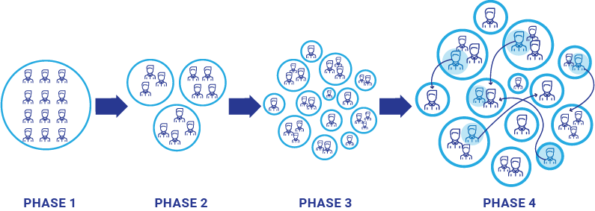
One of AI use case
One of use case, when models detect connections between telemetry and diseases in a large population of users, they assign each user to one of the risk groups and periodically update the estimate of subordination to the group, track the user’s “movement” in the particular group (up or down) and between individual groups (better or worse). And in Phase4 models provides forecast of movement of the user to the next group which allowed to indicate potential health conditions in future.

Slide 25
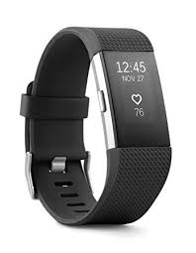
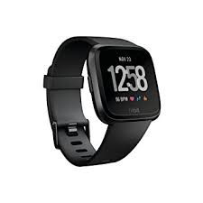
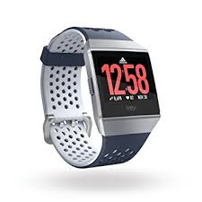
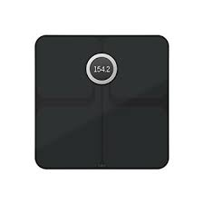
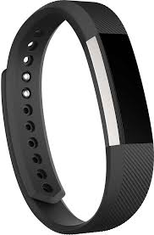
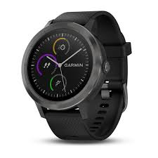
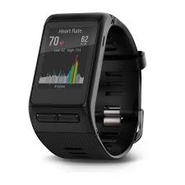
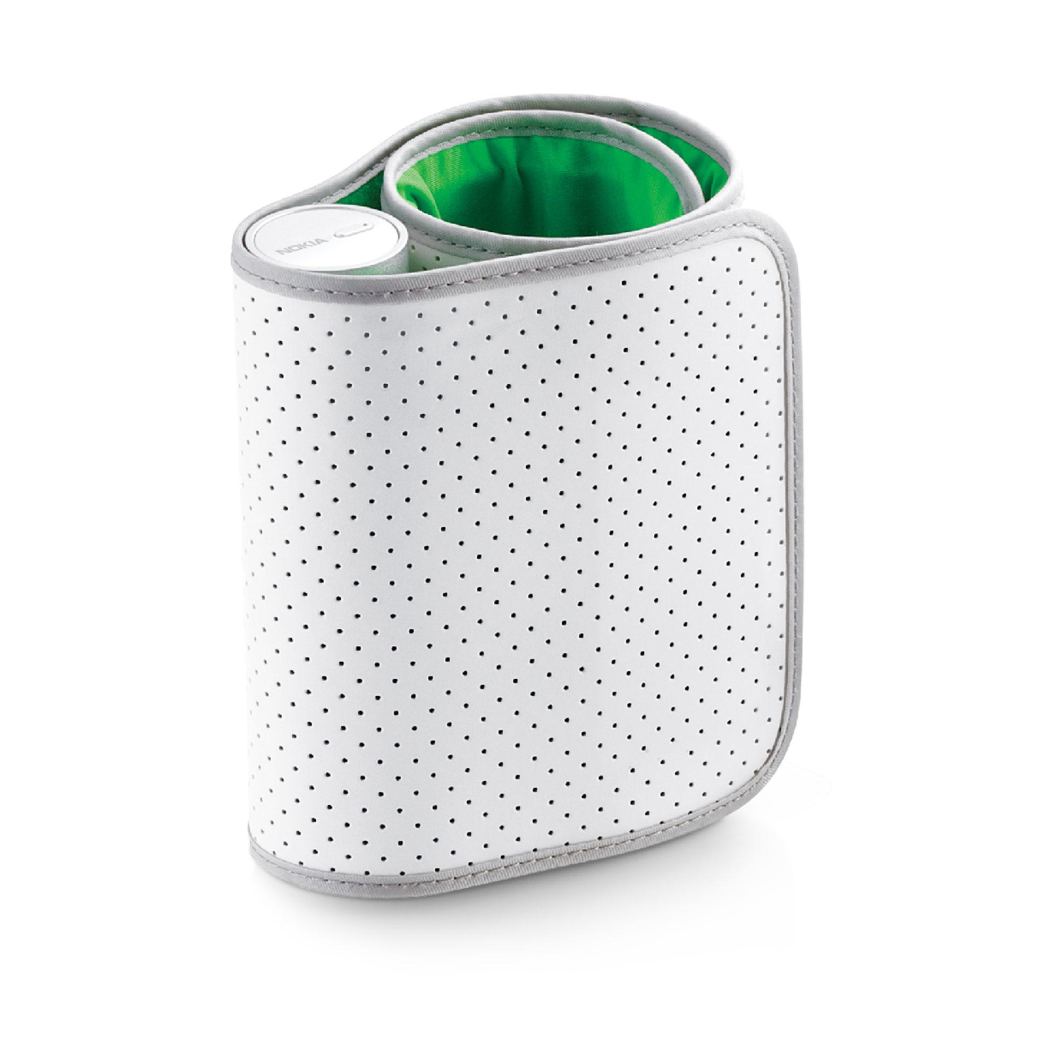
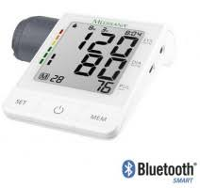
dHealth system integration with providers

Slide 26
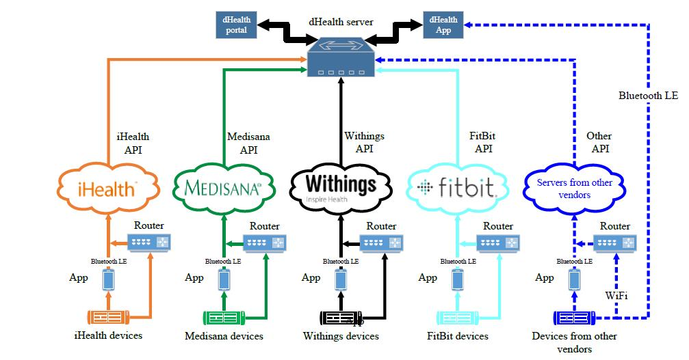
A general scheme for obtaining data from various vendors

Slide 27
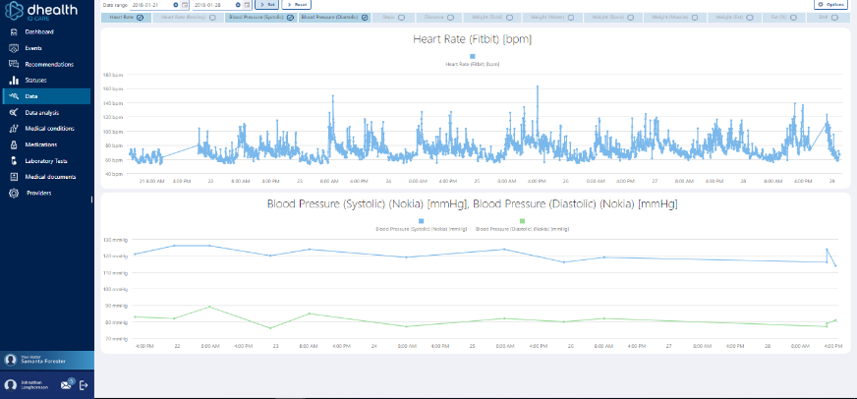
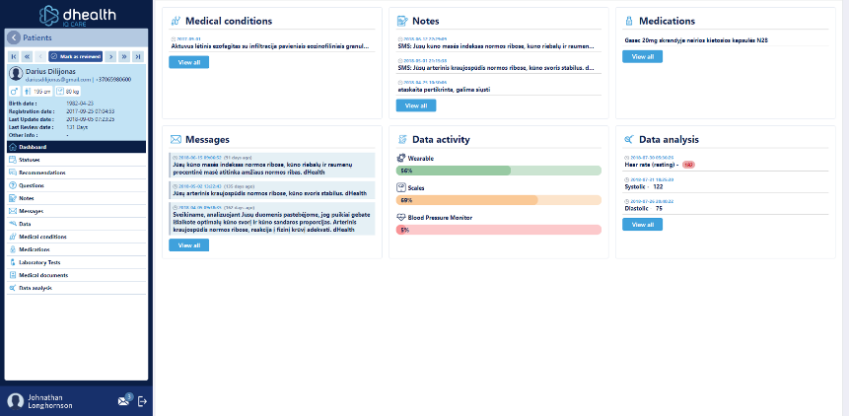
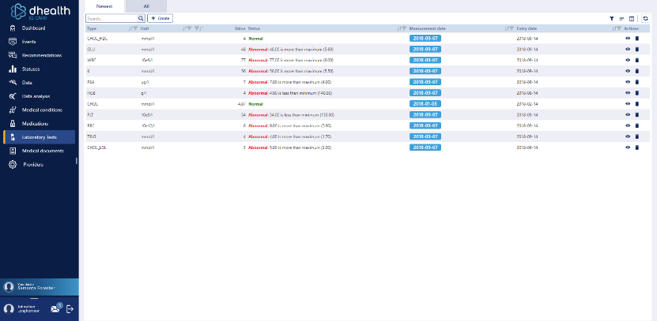
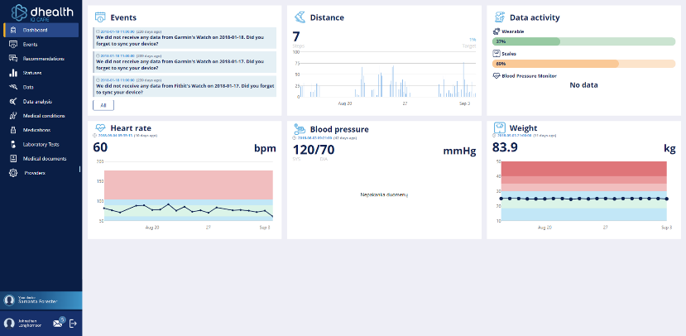
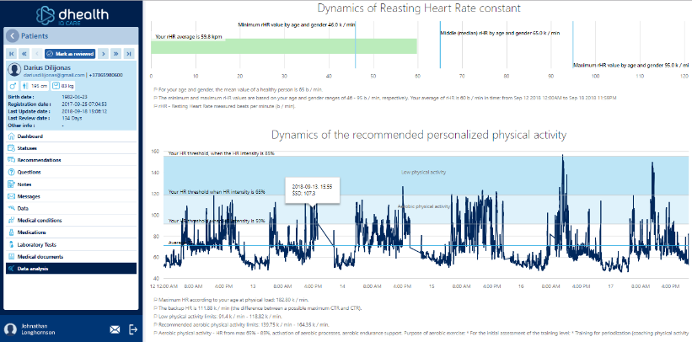
Portal

Slide 28
NEW Market potential for health care providers

Slide 29
Market Potential
Preventive healthcare is fast emerging as the most viable means to cut healthcare costs, making the market for preventive healthcare technologies and services a rapidly developing one.
Transparency Market Research states that the global preventive healthcare technologies and services market will expand at a 9.70% CAGR from 2014 to 2020, with its value rising from US$72.8 bn in 2013 to US$144.8 bn by 2020.
The global preventive healthcare technologies and services market is expected to reach USD 432.4 billion by 2024, according to a new report by Grand View Research, Inc.
Key factors driving the market expansion include the growing awareness about preventive measures, which enhance the quality of life, lifespan, and minimize the possible healthcare spending.
The global mHealth market is expected to reach USD 111.8 billion by 2025, growing at a CAGR of 44.2%, according to a report by Grand View Research, Inc.
The need to reduce long waiting periods to access healthcare facilities from specialists is the primary driver responsible for the adoption of mHealth.

Slide 30
Digital health reached a tipping point and growing
Digital health reached a tipping point as consumers adopted digital health tools at a record rate.
56% of consumers are now considered active digital health adopters, having used three or more categories of digital health tools (e.g., telemedicine, wearables)—up from 19% in 2015.
the majority of health tracking is done mentally—54% of people who track weight and 58% of people who track medications do so in their heads.
Of those tracking their health, the most common metrics recorded using an app are physical activity (44%) and heart rate (31%). The factors least likely to be recorded in an app are blood pressure (14%) and medication adherence (10%)
According to Rockhealth

Slide 31
Digital health adaptation
Source: Rock Health 2016 consumer survey data (n = 4,015)

Slide 32
Wearable adoption
Source: Rock Health 2016 consumer survey data (n = 4,015)

Slide 33
Thank You
Read more:
www.dhealthIQcare.com

